Slide 1

Kinetics of rectilinear motion
In this chapter we will be studying the relationship between forces on a body/particle and the accompanying motion
Newton’s Second law of motion:
Newton’s first and third law of motion were used extensively in the study of statics (the bodies at rest) whereas Newton’s second law of motion is used extensively in the study of the kinetics.
Contd/…

Slide 2
Newton’s Second law (Contd/…)
F
F2
F1
F3
F =Resultant of forces F1,F2 and F₃
Contd/…

Slide 3
Newton’s Second law (Contd/…)
  Consider the Newton’s second law of motion.
  If the resultant force acting on a particle is not zero , the particle will have an acceleration proportional to the magnitude of the resultant force and its direction is along that of the resultant force.
    Where.
F α a F =Resultant of forces
a = Acceleration of the particle.
F= ma
m= mass of the particle.
Contd/…

Slide 4
Newton’s Second law (Contd/…)
The constant value obtained for the ratio of the magnitude of the force and acceleration is characteristic of the particle and is denoted by ‘m’. Where ‘m’ is mass of the particle
Since ‘m’ is a +ve scalar, the vectors of force ‘F’and acceleration ‘a’ have the same direction.
Contd/…

Slide 5
Newton’s Second law (Contd/…)
When the particle is subjected to several forces simultaneously, we have
Σ F = ma
Where Σ F represents the vector sum or resultant of all forces acting on the particle.
We observe that if the resultant of forces acting on the particle is zero (Σ F=0), the acceleration ‘a’ of the particle is zero.
Contd/…

Slide 6
Newton’s Second law (Contd/…)
u=Initial velocity of particle.
v= Velocity of particle at any instant of time.
If the particle is initially at rest (u= 0) , it will remain at rest (v=0). If originally moving with velocity u, the particle will maintain a constant velocity ‘u’ in a straight line. This is Newton’s First law and is a special case of Second law.
Units
Force in Newtons (N) 1 N = 1 Kgm/s²
Acceleration in m/s²
Contd/…

Slide 7
Newton’s Second law (Contd/…)
Using the rectangular coordinate system we have components along axes as,
ΣF_{x} = ma_{x}
ΣF_{y} = ma_{y}
ΣF_{z} = ma_{z}
where F_{x} ,F_{y} F_{z} and a_{x} , a_{y} ,a_{z} are rectangular components of resultant forces and accelerations respectively.
Contd/…

Slide 8
Newton’s Second law (Contd/…)
Newton’s second law may also be expressed by considering a force vector of magnitude ‘ma’ but of sense opposite to that of the acceleration. This vector is denoted by (ma)_{rev}. The subscript indicates that the sense of acceleration has been reversed and is called the inertia force vector.
Contd/…

Slide 9
Newton’s Second law (Contd/…)
It was pointed out by D’Alembert (Alembert, Jean le Rond d’ (1717-1783), French mathematician and philosopher) that problems of kinetics can be solved by using the principles of statics only (the equations of equilibrium) by considering an inertia force in a direction directly opposite to the acceleration in addition to the real forces acting on the system
Contd/…

Slide 10
D’Alembert’s Principle
EQUATION OF MOTION
(DYNAMIC EQUILIBRIUM)
Consider a particle of mass m acted upon by forces
F₁ and F₂.
By Newton’s Second law of motion we have the resultant force must be equal to the vector ‘m a’ .
Thus the given force must be equivalent to the vector ma.
R
m a
=
F₂
R= ma
F₁
Contd/…

Slide 11
D’Alembert’s Principle(Contd/…)
If the inertia force vector is added to the forces acting on the particle we obtain a system of forces whose resultant is zero.
The particle may thus be considered to be in equilibrium. (THIS IS DYNAMIC EQUILIBRIUM)
F₂
R (resultant of F₁ and F₂)
F₁
ma(_{rev})
Contd/…

Slide 12
D’Alembert’s Principle(Contd/…)
The problem under consideration may be solved by using the method developed earlier in statics. The particle is said to be in dynamic equilibrium.
If
ΣF_{x} = 0
ΣF_{y}= 0 including inertia force vector
ΣF_{z} = 0
This principle is known as D’Alembert’s principle
components
Contd/…

Slide 13
D’Alembert’s Principle(Contd/…)
D’Alembert’s principle states that
When different forces act on a system such that it is in motion with an acceleration in a particular direction, the vectorial sum of all the forces acting on the system including the inertia force (‘ma’ taken in the opposite direction to the direction of the acceleration) is zero.

Slide 14
In coplanar force system
y
Direction of motion
F₃
F₁
m
R
m a
m a_{y}
x
F₂
m
m a_{x}
m = mass of the body
a = acceleration of the mass
a_{y} = component of accn. in y direction
a_{x} = component of accn. in x direction
R – m a =0
OR
ΣF_{x} -ma_{x} = 0
ΣF_{y} -ma_{y} = 0

Slide 15
Kinetics if curvilinear motion( Contd/…)
Kinetics of Curvilinear Motion
When a particle is moving along a curved path, then it is subjected to normal and tangential accelerations.
The normal or radial acceleration is directed towards the center of rotation and is termed as Centripetal acceleration.
a_{t}
a_{t}=tangential acceleration
Radius= r
a_{n}=normal acceleration
a_{n}
Contd/…

Slide 16
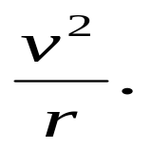
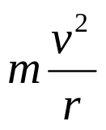

Kinetics if curvilinear motion( Contd/…)
When a particle is moving with constant speed around a curved path it is subjected to a centripetal acceleration of
An acceleration equal in magnitude to the centripetal acceleration but directed away from the center of rotation and multiplied by the mass ‘m’ gives the corresponding inertia force, namely the centrifugal force.
Velocity V
Radius= r
Centrifugal force
Centripetal accn. =
Contd/…

Slide 17
Kinetics if curvilinear motion( Contd/…)
The forces along the normal and tangential directions., likewise may be termed centripetal and tangential forces respectively.
A force in the reverse direction to the centripetal acceleration is termed as the centrifugal force
It may be seen that whereas the centripetal acceleration is a reality, the centrifugal force is just hypothetical.
Contd/…

Slide 18
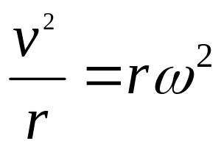
Centrifugal Force
Centripetal acceleration =
Where r = radius of the path ,ω = angular velocity
  v= linear speed .

Slide 19
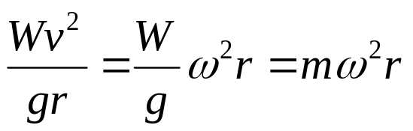
Centrifugal Force (Contd/…)
  Hence by definition, the corresponding inertial force,
Centrifugal force =
The centrifugal force is the outcome of the inertia of the mass resisting change of motion
Contd/…

Slide 20
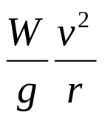
Centrifugal Force (Contd/…)
Motion with a Constant speed in a
Circular path
W
Velocity V
Radius= r
Centrifugal force =
Centripetal acceleration
Centrifugal force
Friction force
If the friction is not enough to negate the Centrifugal force, then the body tends to skid outwards. This friction causes a lot of wear and tear of tyres too. Therefore ‘Banking’ is provided to prevent skidding.
Contd/…

Slide 21

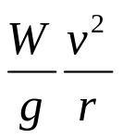

Centrifugal Force (Contd/…)
Banking on Curves (Super Elevation)
W
W
θ
R
N₂
θ
N₁
R = Resultant of N₁ and N₂
Ideal angle of banking ( θ ) is such that frictional forces in radial direction are not brought into action.
Therefore the vehicle is in equilibrium under the action of forces W, and R
Contd/…

Slide 22

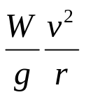
Centrifugal Force (Contd/…)
By Triangular law of forces ,
tan θ =
tan θ =
W
θ
R
W
Contd/…

Slide 23
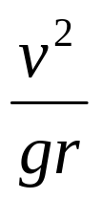
Centrifugal Force (Contd/…)
Therefore Ideal angle of banking is given by
tan θ=
As θ varies with ‘v’, the value of ‘v’ corresponding to any particular angle of banking and radius of the path is called the rated speed for that path and banking.
In banking, the horizontal component of R balances the centrifugal force and vertical component, the weight.
Therefore there is no need for frictional forces.
Contd/…

Slide 24
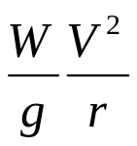
Angle of banking- Friction considered
W
Friction force
R
W
θ
Ф
N
R=resultant of friction and normal reaction N
Φ
N₁
θ
When the speed is greater than the rated speed, friction also comes into picture as the vehicle tends to skid outwards.

Slide 25

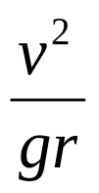

Angle of banking (Contd/…..)
Let Φ = angle of friction=tan⁻¹(µ)
Consider also the impending motion. The resultant of the normal N and friction µN is R.
Therefore for impending motion,
tan (θ+Φ) =
w
tan (θ+Φ) =
θ+Φ = tan⁻¹
θ+Φ
R
W
N

Slide 26

Angle of banking (Contd/…)
tan (θ+Φ) = gives the condition for
velocity beyond which the vehicle will Skid outwards (i.e. upwards). If the value of v is well below the value of rated speed, then the vehicle is likely to Skid inwards (i.e. downwards).

Slide 27
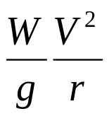
Angle of banking (Contd/…)
For impending motion of Skidding inwards, when (θ>Ф)
W
Friction force
W
Φ
θ
R
N₁
N₁
R
Φ
θ
R=resultant of friction and normal reaction N₁

Slide 28




Angle of banking (Contd/…)
For impending motion of Skidding inwards
tan ( θ-Φ) =
w
tan ( θ-Φ)=
from : tan ( θ-Φ)= is minimum speed
from : tan ( θ+Φ)= is maximum speed
W
Φ
θ
R
N₁

Slide 29
Summary
For rated speed, No friction is considered
tan (θ) =
Maximum speed: beyond which vehicle skids outwards
tan (θ+Φ)=
Minimum speed , below which the vehicle skids inwards
tan ( θ-Φ) =

Slide 30
For Railways
The term used for banking is super elevation (cant). Super elevation is the amount by which the outer rail is raised, relative to the inner rail.
b
e = super-elevation
θ
e = b sinθ
* Here the frictional force is negligible

Slide 31
Problems (Contd/…)
PROBLEMS with solutions
1. A 200N block rests on a horizontal plane. Find the magnitude of the force required to give the block an acceleration of 1m/s² to the right. The coefficient of friction between the block and the plane is 0.25.
200N
30⁰
ma
N
F=0.25N
N₁

Slide 32

Problems (Contd/…)
Solution 1:
Mass of Block m = 200/9.81 = 20.39 kg,
F= μN₁ , a= 1m/s
Σ Fy= 0
N₁ - Psin30 -200 = 0 ------------1
N₁= 200 + P sin30

Slide 33
Problems (Contd/…)
ΣF_{x} = m a_{x}.
Pcos 30 – 0.25N₁ = 20.39 ( 1) -----------2
From eq.2
Pcos30 -0.25(200+Psin30) = 20.39
[0.866-0.125] P -50 =20.39
P = 95 N

Slide 34
Problems (Contd/…)
2. A motorist traveling at a speed of 72kmph suddenly applies his brakes and comes to a stop after skidding 45m. Determine
Time required for the car to stop
The coefficient of friction between the tyres and the pavement.

Slide 35
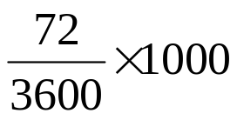
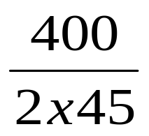
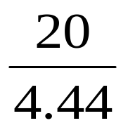
Problems (Contd/…)
Solution 2:
u= = 20m/s , v= 0, s= 45m
v² –u² = 2as
-(20)² = 2 a 45
a = = -4.44 m/s²
v= u + at, 0 = 20 – 4.44×t
t = = 4.5 secs

Slide 36
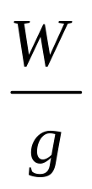
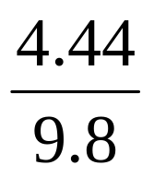
Problems (Contd/…)
+ ΣF_{Y} = 0
W = N₁ …………1
Σ F_{X} = 0
- μN₁ –m(-a) = 0
ma = μN₁ and from 1
.a = μ W
μ = = 0.453
Direction of motion
m a
W
μN₁
N₁

Slide 37
Problems (Contd/…)
3. A body of weight 2kN is resting on a rough plane inclined at 12⁰ to the horizontal. It is pulled up the plane by means of a light flexible rope running parallel to the plane and passing over a light frictionless pulley at the top of the plane. The portion of the rope beyond the pulley hangs vertically down and carries a weight of 1kN at the end. If friction between the body and plane is 0.2 , find;
Tension in the rope
Acceleration with which the body moves up the plane
Distance moved by the body in 4 secs after starting from rest

Slide 38
Problems (Contd/…)
2kN
T
A
T
12⁰
B
1kN
here, acceleration of block A is equal to acceleration of block B, hence a_{A}=a_{B}

Slide 39
y
Problems (Contd/…)
2kN
a_{A}
ma_{A}
x
T
ΣF_{x} =0
-2 sin 12 +T-0.2N₁-(2/9.81)a_{A}=0
(1)
0.2 N₁
Σ F_{y}= 0
2 cos 12 – N₁=0
N₁=1.956 N
Substitute N₁ in eq. 1
-0.415 + T – 0.3912 -0.203 a_{A}=0
12⁰
N₁
FBD of A
(2)
y
T
Σ F_{y}= 0
m_{B} a_{B}
T – 1 + m_{B} a_{B}=0
T – 1 + (1/9.81)a_{B}=0
B
a_{B}
(3)
Solving (1) (2) and (3)
T=0.935 kN
2. a_{A}=0.637 m/s² = a_{B}
FBD of B

Slide 40
Problems (Contd/…)
t=4 s u=0 and a=0.637 m/s²
Distance traveled s= (½) a t²
s=5.096 m

Slide 41
Problems (Contd/…)
Problems
4. A train whose weight is 20kN moves at the rate of 60kmph. After brakes are applied, it is brought to rest in 500m. Find the force exerted, assuming it to be uniform.
Solution:
u= 60 kmph = 16.67 m/s, v= 0 , s = 500m
v² –u² = 2as
- (16.67)² = 2a 500
a= -2.778 m/s^{2 ,} F = ma
F = 20/9.81 ×2.778 = 5.663 kN

Slide 42
Problems (Contd/…)
5. The blocks A and B having weights 100 N and 300 N start from rest. The horizontal plane and the pulleys are frictionless. Determine the acceleration and the tension in the string.
string
Frictionless pulley
A
string
Frictionless pulley
B

Slide 43
Problems (Contd/…)
Solution.1;
Here a_{A}= 2a_{B}
Consider FBD of block A:
ΣF_{x} =0
y
m_{A}a_{A}
W
T= m_{A}a_{A}
T=(100/9.81) a_{A}
a_{A}
(1)
T
x
N₁
T
T
FBD of block B
Σ F_{y}= 0
w_{B}=2T+m_{B}a_{B}
300=2T+(300/9.81)a_{B}
a_{B}
m_{B}a_{B}
( 2)
W_{B}

Slide 44
Problems (Contd/…)
We also know that a_{A}= 2a_{B}
Solving equations (1), (2) and (3) we get;
a_{A}=8.403 m/s2
a_{B}=4.201 m/s2
T= 85.71 N
(3)

Slide 45
Problems (Contd/…)
6. An automobile racing track is laid at a radius of 300m. The track is so designed that when car travels at a speed of 150kmph , the reaction from the pavement is perpendicular to the surface of the track. Find the banking angle.
90º
θ

Slide 46

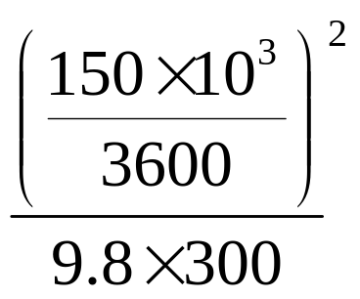
Problems (Contd/…)
Solution 6: As the force between the track and car is perpendicular to the track , there is no frictional force involved.
tan θ = = = 0.59
= 30. 56⁰
θ

Slide 47


Problems (Contd/…)
7. In a circus show, a motorcyclist is moving inside a spherical cage of radius 3m. The motorcycle and the man together weigh 7250N. Find the least velocity with which the motorcycle must pass the highest point on the cage without losing contact of the inside of the cage.
7250 N
r

Slide 48
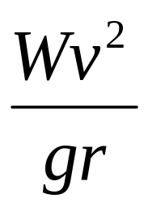
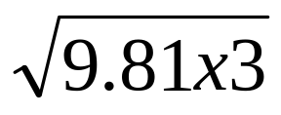
Problems (Contd/…)
Solution7:For Motorcyclist not to lose contact
= 7250 N
= 1
v² = 9.81 x 3
v=
v= 5.42 m/s or 19.52kmph

Slide 49
Problems (Contd/…)
8. A road curve has radius of 250m. It is banked to have no side thrust for a vehicle speed of 54 Kmph. Find the safe velocity for avoiding skidding if μ = 0.25.
W
R
θ

Slide 50
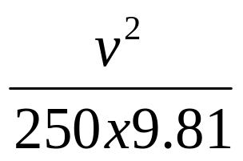
Problems (Contd/…)
Solution8:Rated speed = 54 Kmph
θ = tan-1 = 5.24⁰
max speed
tan( θ + Φ) =
tan (14.03 + 5.24) =
v= 105.43Kmph

Slide 51
Problems (Contd/…)
9. A car is negotiating a 200m radius curve at a speed of 20Kmph. What is the minimum Coefficient of friction required to prevent skidding on a level road. If the coefficient of friction is 0.4, then what is the maximum speed .
W
μN
N

Slide 52
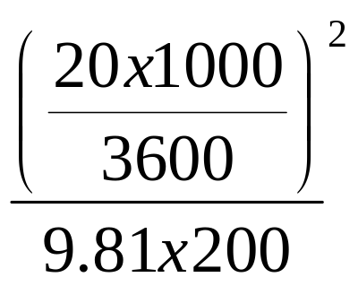
Problems (Contd/…)
Solution 9:
To prevent Skidding
μ.W =
μ = = 0.015

Slide 53
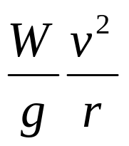
Problems (Contd/…)
ii) Maximum speed if μ = 0.4
0.4 . w =
0.4 × 9.81 × 200 = v²
v= 28.01m/s or 100.85 Kmph

Slide 54
Problems (Contd/…)
10. Determine the super elevation of rail road track having a gauge of 1.435m and of radius 610m if the rated speed is 96Kmph. What is the flange pressure on the wheels if a rail car of weight 445kN goes round the curve of 130Kmph.
1.435m
e = super-elevation
θ

Slide 55

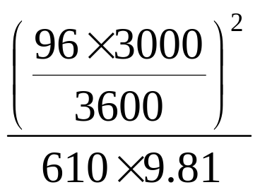
Problems (Contd/…)
Solution 10:
tan θ = =
θ = 6.78⁰
super elevation;
e /1.435 = sinθ
therefore e =0.169 m
1.435m
θ

Slide 56
EXERCISE PROBLEMS
1. Blocks A and B of mass 10 kg and 30 kg respectively are connected by an inextensible cord passing over a smooth pulley as shown in Fig. Determine the velocity of the system 4 sec. after starting from rest. Assume coefficient of friction =0.3 for all surfaces in contact.
A
B
60º
30º
Ans: v=28.52m/s

Slide 57
Exercise prob (Contd/…)
2. Find the tension in the cord supporting body C in Fig. below. The pulley are frictionless and of negligible weight.
A
C
150 kN
300 kN
B
450 kN
Ans : T=211.72 kN

Slide 58
Exercise prob (Contd/…)
3. Two blocks A and B are released from rest on a 30º inclined plane with horizontal, when they are 20m apart. The coefficient of friction under the upper block is 0.2 and that under lower block is 0.4. compute the time elapsed until the block touch. After they touch and move as a unit what will be the constant forces between them.
(Ans : t = 4.85 s, contact force=8.65 N)

Slide 59
Exercise prob (Contd/…)
4. When the forward speed of the truck was 9m/s the brakes were applied causing all four wheels to stop rotating. It was observed that the truck skidded to rest in 6m. Determine the magnitude of the normal reaction and the friction force at each wheel as the truck skidded to rest.
c.g
1.2 m
1.5 m
2.1 m
Ans: R front=0.323 W, R rear = 0.172 W, F front =0.222 W and F rear =0.122 W

Slide 60
Exercise prob (Contd/…)
5.An elevator cage of a mine shaft weighing 8kN when empty is lifted or lowered by means of rope. Once a man weighing 600N entered it and lowered at uniform acceleratin such that when a distance of 187.5 m was covered, the velocity of the cage was 25m/s. Determine the tension in the cable and force exerted by man on the floor of the cage.
(Ans: T=7139 N and R=498 N)

Slide 61
Exercise prob (Contd/…)
6. An Aeroplane files in a horizontal circle at a constant speed of 250 kmph. The instrument show that the angle of banking is 30º. Calculate the radius of this circle, if the plane weighs 50 kN. (Ans: 851m)
7. What is the maximum comfortable speed of a car along a curve of radius 50m, if the road is banked at a angle of 20º.
(Ans: v=48.1 kmph)

Slide 62
Exercise prob (Contd/…)
8. A car weighing 20kN rounds a curve of 60m radius banked at an angle of 30º. Find the friction force acting on the tyres when the car is travelling at 96 kmph. The coefficient of friction between the tyres and road is 0.6.
(Ans: F=10.9 kN)
9. A cyclist is riding in a circle of radius 20 m at a speed of 5 m/s. what must be the angle to the vertical of the centre line of the bicycle to ensure stability?
(Ans: 7.27º)

Slide 63
Exercise prob (Contd/…)
10. An automobile weighing 60 kN and travelling at 48kmph hits a depression in the road which has radius of curvature of 1.5m. What is the total force to which the springs are subjected to.
(Ans: 132.5 kN)
THANK YOU

